Slide 1
Artificial Intelligence in Medicine
Global Health Congress
Paata Gogishvili
Associate Professor at ILIA STATE UNIVERSITY

Slide 2
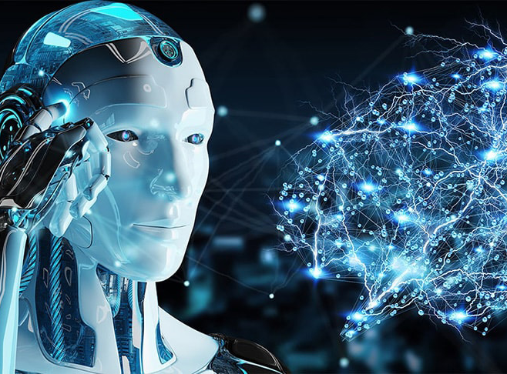
What is Artificial Intelligence (AI)

Slide 3
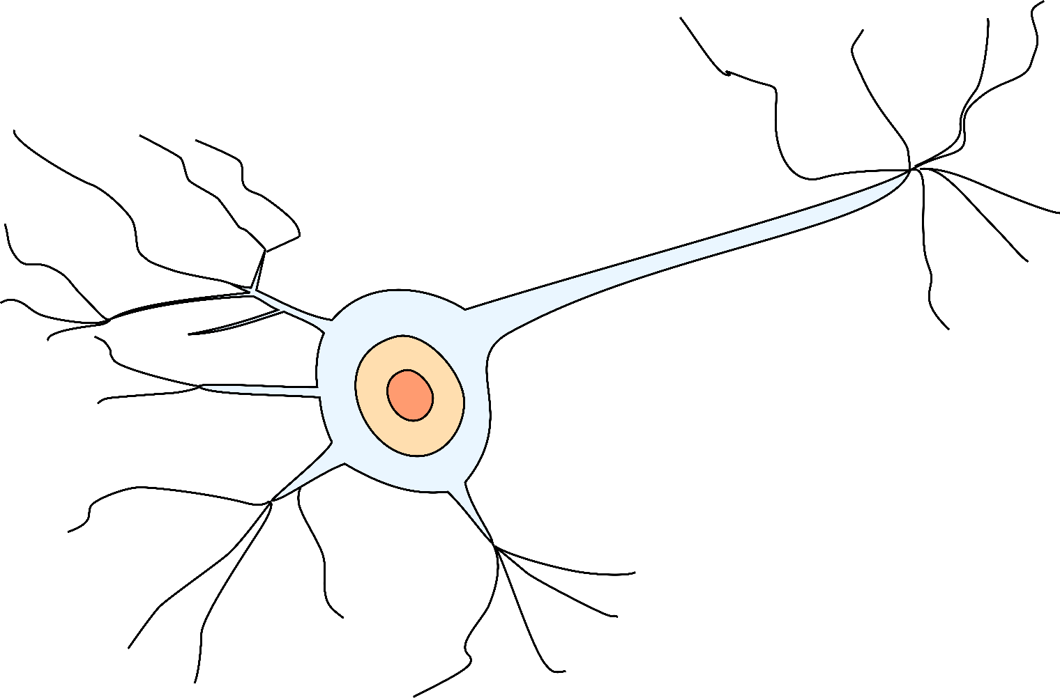
If we assume that the brain is just interconnected neurons
Dendrites
Axon
Dendrites
Dendrites
Our intelligence is in the network of neurons

Slide 4
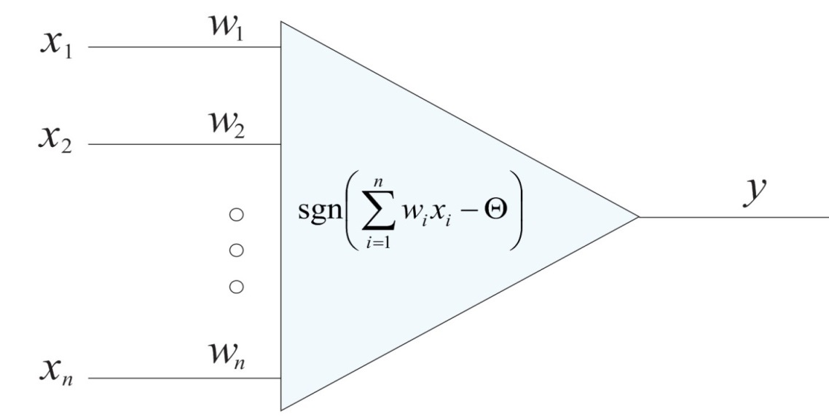
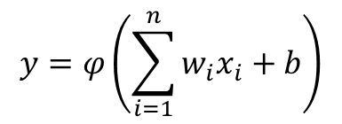
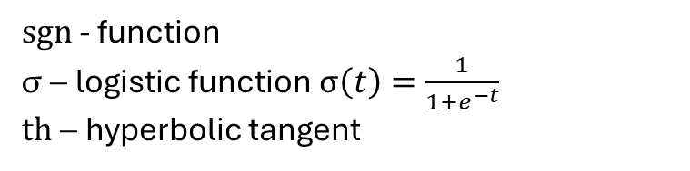
What If we create artificial neurons
$sgn$ - function
σ – logistic function $σ\left(t\right)=\frac{1}{1+e^{−t}}$
$th$ – hyperbolic tangent
$$y=φ\left(\sum_{i=1}^{n}{w_{i}x_{i}+b}\right)$$

Slide 5
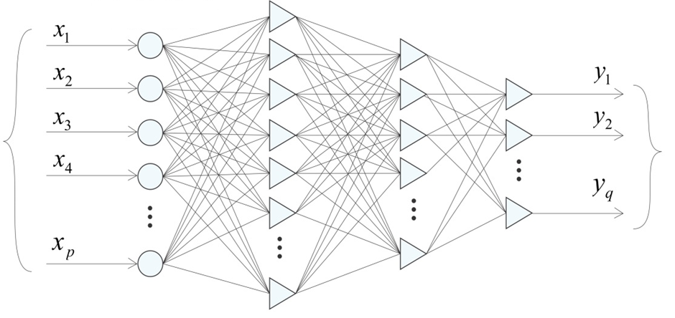
If we create artificial neurons and connect them, we will get artificial neural network
Signal
Distribution
Input Signals
Output Signals
Hidden Layer of Neurons
Hidden Layer of Neurons
Hidden Layer of Neurons

Slide 6
If we create artificial neurons and connect them, we will get artificial neural network
Signal
Distribution
Input Signals
Output Signals
Hidden Layer of Neurons
Hidden Layer of Neurons
Hidden Layer of Neurons
It turns out, that such artificial brain works quite well!

Slide 7
If we create artificial neurons and connect them, we will get artificial neural network
Signal
Distribution
Input Signals
Output Signals
Hidden Layer of Neurons
This analog of the human intelligence is called the
Artificial Intelligence
Hidden Layer of Neurons
Hidden Layer of Neurons
It turns out, that such artificial brain works quite well!

Slide 8
Important Milestones of AI

Slide 9
Important Milestones of AI
First Conference - 1956 - Dartmouth Conference, coined "Artificial Intelligence"

Slide 10
Important Milestones of AI
First Conference - 1956 - Dartmouth Conference, coined "Artificial Intelligence"
First Winner - 1997 - IBM Deep Blue defeats Chess champion

Slide 11
Important Milestones of AI
First Conference - 1956 - Dartmouth Conference, coined "Artificial Intelligence"
First Winner - 1997 - IBM Deep Blue defeats Chess champion
Winner in Image Classification – 2015 – ResNet.

Slide 12
What did AI
First Conference - 1956 - Dartmouth Conference, coined "Artificial Intelligence"
First Winner - 1997 - IBM Deep Blue defeats Chess champion
Winner in Image Classification – 2015 – ResNet.
Human Error – 5.1 %
AI Error – 4.9 %

Slide 13
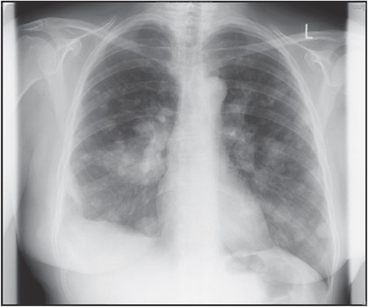
Application of the Image Classification
AI shows remarkable capabilities in specific radiology tasks. Google's DeepMind for breast cancer detection—outperformed expert radiologists in accuracy.
Is rapid, accurate detection in screening tasks (mammography, fracture detection)
Availability 24/7
Has reduced human error in routine cases
Consistent performance across large volumes

Slide 14
Application of the Image Classification
AI shows remarkable capabilities in specific radiology tasks. Google's DeepMind for breast cancer detection—outperformed expert radiologists in accuracy.
Is rapid, accurate detection in screening tasks (mammography, fracture detection)
Availability 24/7
Has reduced human error in routine cases
Consistent performance across large volumes
Human Value:
Clinical context interpretation
Complex, rare case analysis
Patient and physician communication
Treatment recommendations
Ethical and legal accountability
Holistic patient care integration
AI will likely become a powerful diagnostic tool that enhances radiologist efficiency and accuracy.
The profession will evolve toward AI-assisted practice, combining human expertise with machine precision.

Slide 15
Genomic sequencing and AI prediction of patient-specific drug effectiveness
The human genome contains approximately 3 billion base pairs, generating massive datasets that exceed human analytical capacity. AI systems can process and analyze these vast quantities of genomic data simultaneously, identifying subtle mutation patterns and complex genetic variants that would be difficult or impossible for clinicians to detect through traditional analysis methods.
The process begins with sequencing a patient's genome to identify genetic variants that affect drug metabolism, efficacy, and adverse reactions.
AI algorithms then analyze this genetic data alongside other factors like medical history, demographics, and sometimes additional biomarkers to predict how the patient will respond to different treatment options.

Slide 16
Genomic sequencing and AI prediction of patient-specific drug effectiveness
In oncology, this approach is particularly advanced. Tumor sequencing can identify specific mutations that make cancers vulnerable to targeted therapies. For example, patients with BRCA mutations may respond better to PARP inhibitors, while those with specific lung cancer mutations might benefit from targeted kinase inhibitors.
Psychiatric medications represent another important application. Genetic variants in cytochrome P450 enzymes affect how quickly patients metabolize antidepressants, helping predict both effectiveness and side effect risk. This can help avoid the current trial-and-error approach that often leaves patients trying multiple medications.

Slide 17
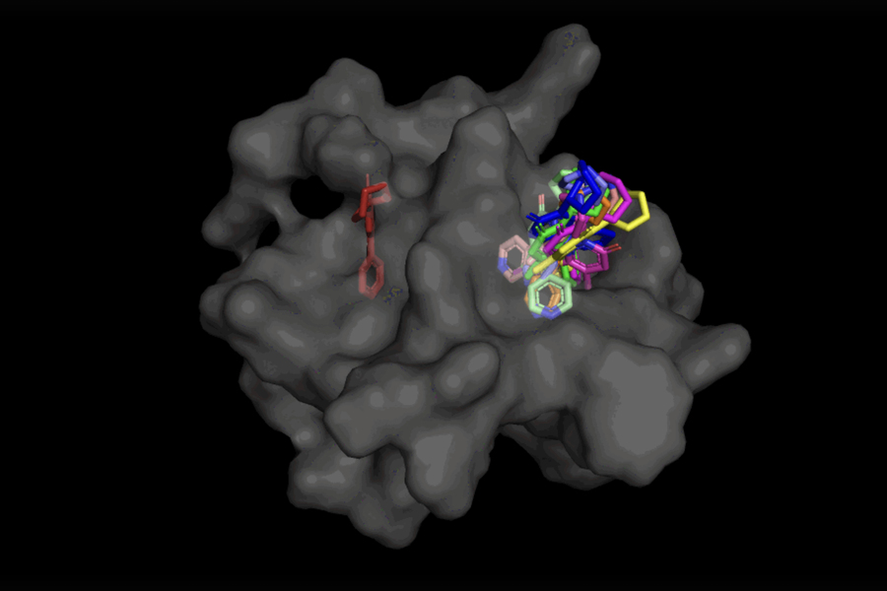
Faster drug discovery processes with AI simulation models

Slide 18
Faster drug discovery processes with AI simulation models
AI simulation models accelerate drug discovery in several key ways:
Molecule Screening and Candidate Selection: AI rapidly analyzes vast databases to predict the biological activity and efficacy of molecules based on their structure. This reduces the number of potential candidate molecules that need experimental testing.
Protein Structure Prediction: AI tools, such as Google DeepMind's AlphaFold, have dramatically sped up protein structure prediction from years to minutes. This allows scientists to better understand how proteins function and design targeted molecules.
Novel Molecule Generation: Generative AI models can create entirely new molecules designed to bind to specific targets and exhibit desired properties, facilitating the discovery of innovative compounds.
Clinical Trial Optimization: AI analyzes patient data and clinical trial results to predict drug efficacy and side effects. This helps improve clinical trial design, select appropriate patients, and reduce risks.
Practical Example is AI accelerated COVID-19 vaccine research.

Slide 19
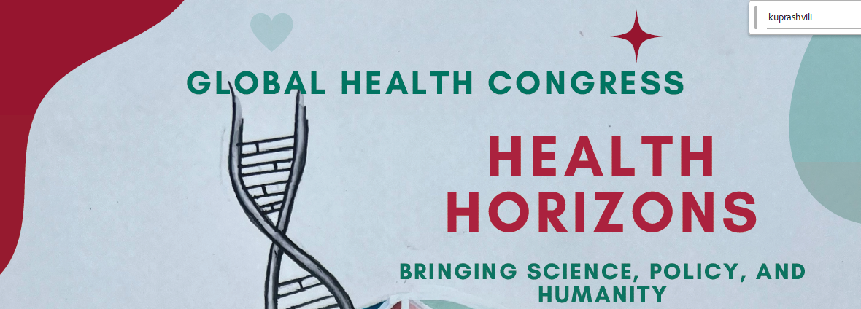
Medical Literature Analysis and AI prediction
With thousands of peer-reviewed medical publications released daily, AI can continuously scan, analyze, and synthesize the entire corpus of biomedical literature. This enables real-time identification of new gene-drug interactions, emerging therapeutic targets, and novel associations between genetic variants and drug responses that would otherwise remain buried in the literature.

Slide 20
Clinical Decision Support
AI systems can assist physicians in determining optimal medication selection, dosing strategies, and risk stratification by integrating genomic data with clinical parameters. This provides evidence-based recommendations tailored to individual patient genetic profiles, moving beyond traditional population-based prescribing approaches.
Practical Example:
Consider a patient with specific variants in CYP2D6, CYP2C19, COMT, and MTHFR genes. AI can simultaneously analyze global literature on these variant combinations, compare outcomes from thousands of similar patients, and recommend personalized medication regimens with predicted efficacy and side effect profiles that would be impossible to derive through conventional clinical assessment alone.

Slide 21
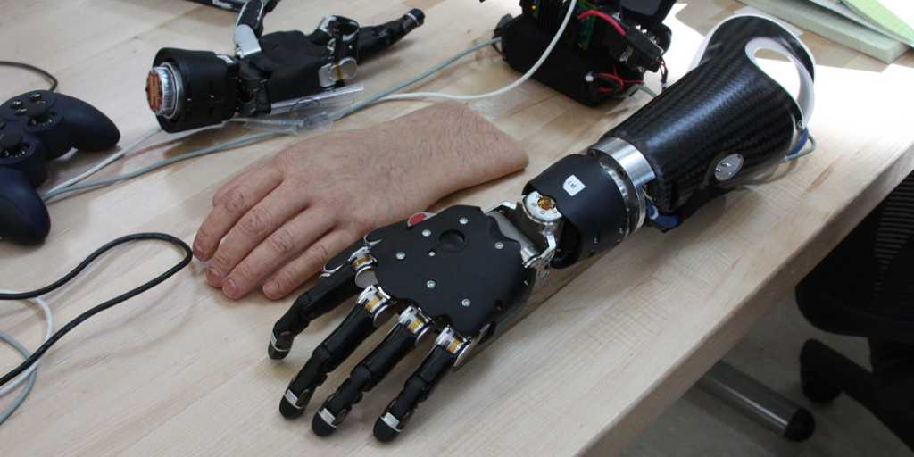
AI in Prosthetics

Slide 22
AI in Prosthetics
Artificial intelligence (AI) is revolutionizing prosthetics, transforming them from passive devices into intelligent, responsive extensions of the user. This integration significantly enhances functionality, control, and user experience.
AI algorithms interpret signals from the user's muscles (myoelectric signals) or nerves, allowing for more natural and precise control over the prosthetic limb. This means the prosthetic can respond almost instinctively to the user's intended movements.
AI enables prosthetics to learn and adapt to various environments and activities (e.g., walking on stairs, uneven terrain). The prosthetic can automatically adjust its gait or grip, optimizing performance and stability in real-time.
AI processes data from sensors embedded in the prosthetic (touch, pressure, temperature). This information is then translated into haptic feedback (e.g., vibrations or electrical impulses) that the user can perceive, restoring a sense of touch.
Continuous Learning & Improvement: Modern AI-powered prosthetics can learn from user patterns over time, improving their performance and adaptability. Data analysis driven by AI also fuels the development of even more advanced prosthetic technologies.

Slide 23
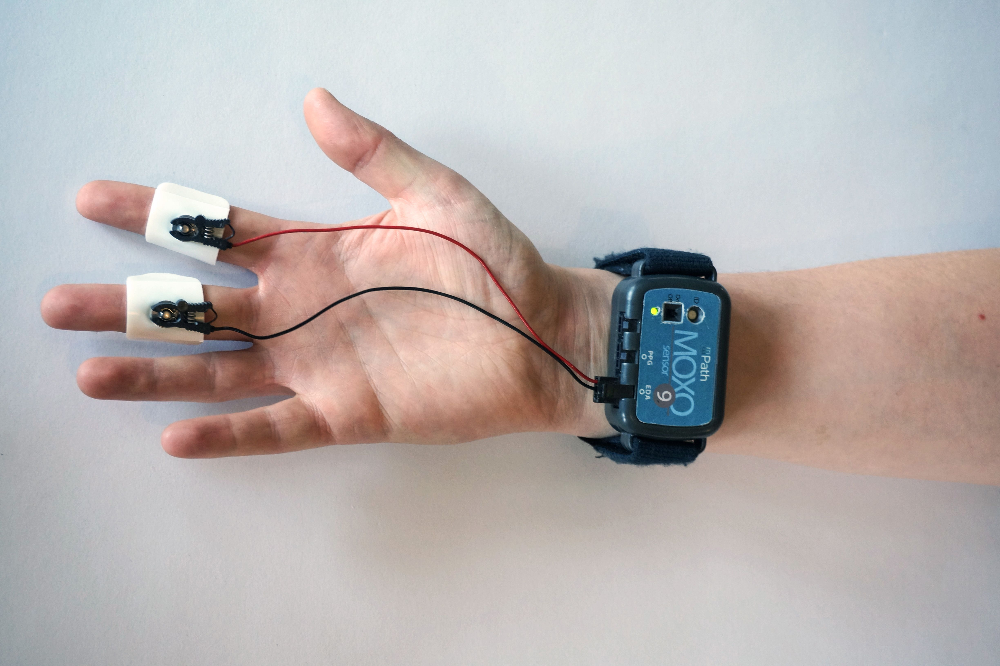
Patient Monitoring & Predictive Analytics

Slide 24
Patient Monitoring & Predictive Analytics
Wearable devices are electronic gadgets that users wear directly on their bodies or integrate into their clothing. These devices are equipped with various sensors capable of continuously collecting physiological and activity data.
In recent years, they've gained significant popularity in healthcare by enabling constant monitoring of our health in daily life. This data typically includes:
Heart rate
Sleep quality and duration
Physical activity (steps, distance, calories burned)
And in some advanced cases, blood glucose levels, blood oxygen saturation, and skin temperature.
The main advantage of wearables is their continuous monitoring capability. This creates a comprehensive and detailed picture of a patient's health status, rather than just relying on single, point-in-time information gathered during a doctor's visit. This technology is significantly transforming the healthcare landscape by enhancing patient engagement in managing their own health and serving as an invaluable source for predictive analytics.
AI is best in dealing with the vast amount of data, so It can process the data from the wearable device and make predictions.

Slide 25
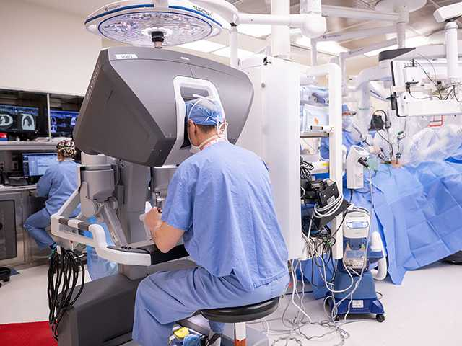
Robotic surgery, enhanced by artificial intelligence (AI)
AI enables robotic systems to perform tasks with exceptional accuracy, surpassing human capabilities. Robots can execute intricate maneuvers, even in confined spaces, with a level of consistency unaffected by fatigue or human tremor. This is crucial in delicate procedures like tumor resections, organ transplants, and minimally invasive surgeries, where precision is paramount to avoid damaging healthy tissue and surrounding organs.
AI algorithms process vast amounts of data to provide surgeons with detailed, magnified 3D views of the surgical site. This advanced imaging capability improves the surgeon's ability to navigate complex anatomical structures, leading to better surgical outcomes.
AI assists in minimizing human error by performing tasks with high accuracy and consistency. For example, robotic systems can automatically adjust for hand tremors, ensuring steady and controlled movements. By learning from previous surgeries, AI systems optimize surgical strategies and identify trends, further reducing errors.

Slide 26
Current Challenges in Medicine
Increasing patient loads
Limited medical resources

Slide 27
Current Challenges in Medicine
Increasing patient loads
Limited medical resources
You arrive at your scheduled doctor's appointment and wait in line, finally entering after a long delay.
The exhausted doctor only partially remembers your medical history.
Some people enter in the room during the visit and interrupt the session.
Fatigue causes you to forget to mention all your symptoms completely. You remember what you missed only after leaving the office.
Due to both your schedule and the doctor's availability, the next appointment can only be scheduled a week later.
At the second visit, the original doctor is on vacation, and you must start the conversation about your symptoms all over again with a new doctor who knows nothing about your case.

Slide 28
Current Challenges in Medicine
Increasing patient loads
Limited medical resources
You arrive at your scheduled doctor's appointment and wait in line, finally entering after a long delay.
The exhausted doctor only partially remembers your medical history.
Some people enter in the room during the visit and interrupt the session.
Fatigue causes you to forget to mention all your symptoms completely. You remember what you missed only after leaving the office.
Due to both your schedule and the doctor's availability, the next appointment can only be scheduled a week later.
At the second visit, the original doctor is on vacation, and you must start the conversation about your symptoms all over again with a new doctor who knows nothing about your case.

Slide 29
More Challenges
Medical Mistakes: 250,000 deaths yearly from human error in US alone. Have data for Georgia.
Rural Areas: No specialists available, patients travel long distances for care.
Low Qualification: Not all specialists are professionals.

Slide 30
Need for AI doctors

Slide 31
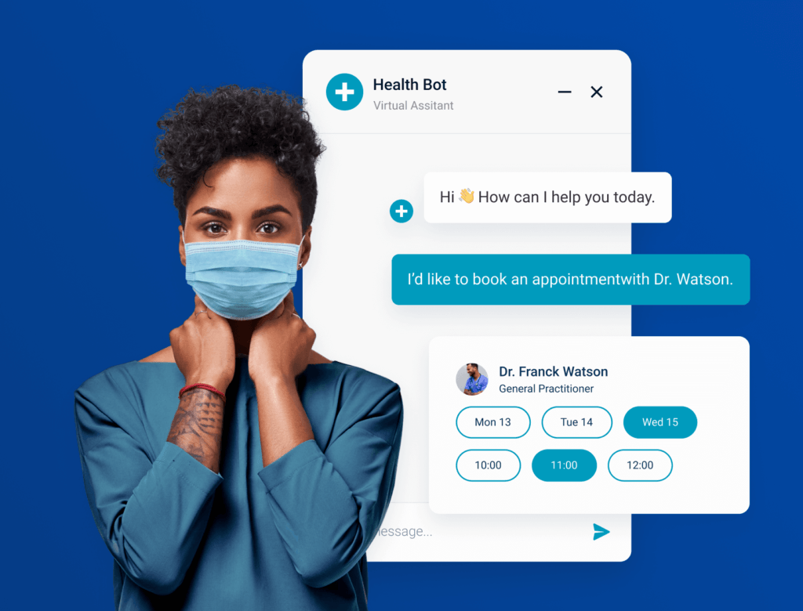
Medical AI Chat-bots
AI chatbots are revolutionizing healthcare by providing accessible, immediate support to patients across various medical scenarios. These intelligent conversational agents serve as the first point of contact for many healthcare interactions, offering everything from basic symptom assessment to ongoing chronic disease management.
The level of empathy is higher in Chat-bots rather is statistical medical personnel.

Slide 32
Patient Support and Initial Consultation
Medical chatbots have become invaluable in providing preliminary healthcare guidance. When patients experience symptoms or have health concerns, these AI systems can conduct initial assessments by asking targeted questions about symptoms, medical history, and current medications. Rather than waiting for appointments or calling busy medical offices, patients can receive immediate guidance on whether their symptoms require urgent attention or can be managed at home. These chatbots also excel at answering routine health questions, explaining test results in simple terms, and providing medication reminders that help patients adhere to treatment plans.
Emergency Assessment
One of the most critical applications of medical chatbots is in triage situations. These systems can quickly evaluate the severity of symptoms and determine the appropriate level of care needed. For instance, a chatbot might recognize that chest pain combined with shortness of breath requires immediate emergency attention, while a minor headache might be manageable with over-the-counter medication and rest. This capability is particularly valuable in overwhelmed healthcare systems, as it helps direct patients to the most appropriate care setting and reduces unnecessary emergency room visits.

Slide 33
Mental Health Support
The mental health applications of AI chatbots have shown remarkable promise, especially given the global shortage of mental health professionals. These systems provide 24/7 support for individuals experiencing depression, anxiety, or other mental health challenges. Unlike human therapists who have limited availability, AI chatbots can offer immediate intervention during crisis moments, guide users through breathing exercises or mindfulness techniques, and provide consistent emotional support. Some advanced systems even incorporate cognitive behavioral therapy techniques, helping users identify negative thought patterns and develop coping strategies.
Chronic Disease Management
For patients with chronic conditions like diabetes, hypertension, or heart disease, AI chatbots serve as constant companions in managing their health. These systems can remind patients to take medications, track daily symptoms, monitor vital signs, and even detect concerning patterns that might indicate the need for medical intervention. The continuous monitoring capability means that healthcare providers receive regular updates on their patients' conditions, allowing for more proactive and personalized care.

Slide 34
Ethical and Safety Considerations of AI in Medicine
Patient Privacy and Data Security
Medical AI systems require vast amounts of sensitive patient data to function effectively. This creates substantial privacy risks, as healthcare records contain intimate details about individuals' health conditions, genetic information, and personal histories.
Algorithmic Bias and Health Equity
AI systems can perpetuate or amplify existing healthcare disparities if trained on biased datasets. Historical medical data often reflects systemic inequalities, potentially leading to AI models that provide suboptimal care for underrepresented populations. For instance, diagnostic algorithms trained primarily on data from certain demographic groups may perform poorly when applied to patients from different ethnic backgrounds or socioeconomic conditions.
If AI makes wrong diagnosis, who gets sued - doctor or AI company?
The introduction of AI in clinical settings raises complex questions about professional responsibility. When an AI system makes an error, determining liability becomes challenging. Healthcare providers must maintain their clinical judgment and not become overly dependent on AI recommendations.
Transparency and Explainability
Many AI systems, particularly deep learning models, operate as "black boxes" where the decision-making process is opaque. In healthcare, this lack of transparency poses serious concerns.

Slide 35
Will AI replace medical personnel?
The decisions are driven by data, diagnostics are enhanced by AI, and healing is amplified by human-machine collaboration.
I think that future is human medical personnel with AI.
And together, we can offer better care, deeper understanding, and longer, healthier lives.

